Slide 1
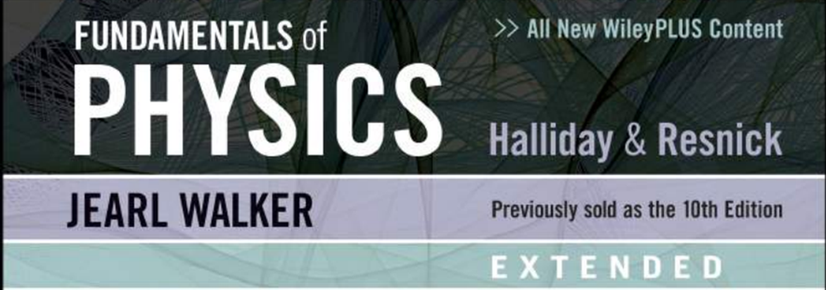

NEWTON LAWS OF MOTION, FORCES (1D/2D): GRAVITATIONAL, FRICTION, TENSION, WEIGHT
Chapter 5: Forces and Newton’s Laws of Motion

Slide 2
Outline
Force
Mass
Newtons first law
Newton second law
Free body diagram
Newton third law of motion
Weight
Normal Force
Friction forces
Tension

Slide 3
5.1 The Concepts of Force and Mass
A force is a push or a pull.
Arrows are used to represent forces. The length of the arrow
is proportional to the magnitude of the force.
15 N
5 N

Slide 4
Contact force
Non-contact force
The push or pull of one object by another that is touching it
Can be either weak or strong
Example: pressing keys on a keyboard
Force that one object can apply to another object without touching it
Examples:
Magnetic force
Gravity

Slide 5
What is Force?
Forces have Both
Strength
Direction
Represented by arrows
Length of the arrow shows how much strength is being applied to an object
Different things can happen when applying force from different directions

Slide 6
5.1 The Concepts of Force and Mass
Mass is a measure of the amount
of “stuff” contained in an object.

Slide 7
5.2 Newton’s First Law of Motion
Newton’s First Law (Law of Inertia)
An object continues in a state of rest
or in a state of motion at a constant
Speed unless changed by a net force
The net force is the SUM of all
of the forces acting on an object.

Slide 8
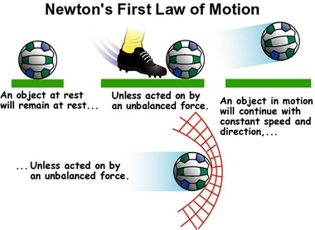

Slide 9
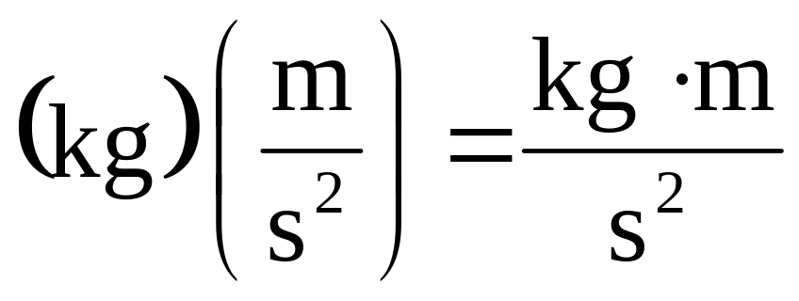
5.3 Newton’s Second Law of Motion
SI Unit for Force
This combination of units is called a newton (N).

Slide 10
5.2 Newton’s First Law of Motion
Net force: The net force on an object is the sum of all forces acting on that object.
Individual Forces
Net Force
4 N
10 N
6 N

Slide 11

5.2 Newton’s First Law of Motion
Individual Forces
Net Force
5 N
3 N
4 N

Slide 12
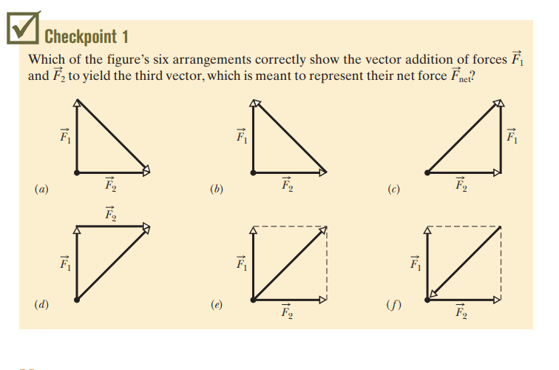

Slide 13
5.2 Newton’s First Law of Motion
The mass of an object is a quantitative
measure of inertia.
SI Unit of Mass: kilogram (kg)

Slide 14
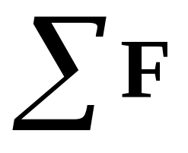
5.3 Newton’s Second Law of Motion
Mathematically, the net force is
written as
where the Greek letter sigma denotes the vector sum.

Slide 15

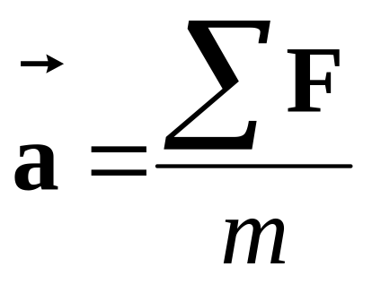
5.3 Newton’s Second Law of Motion
Newton’s Second Law
When a net external force acts on an object
of mass m, the acceleration that results is
directly proportional to the net force and has
a magnitude that is inversely proportional to
the mass. The direction of the acceleration is
the same as the direction of the net force.

Slide 16
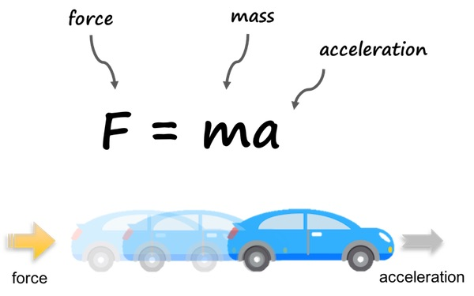

Slide 17
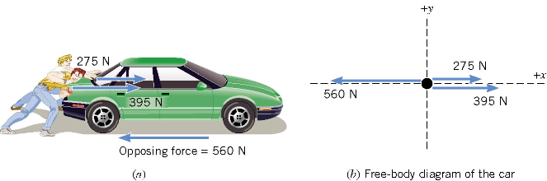
5.3 Newton’s Second Law of Motion
A free-body-diagram is a diagram that
represents the object and the forces that
act on it.

Slide 18
5.3 Newton’s Second Law of Motion
The net force in this case is:
275 N + 395 N – 560 N = +110 N
and is directed along the + x axis of the coordinate system.

Slide 19
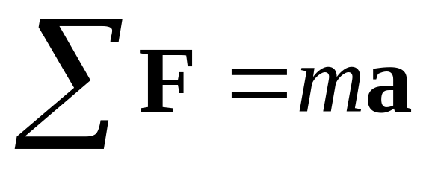
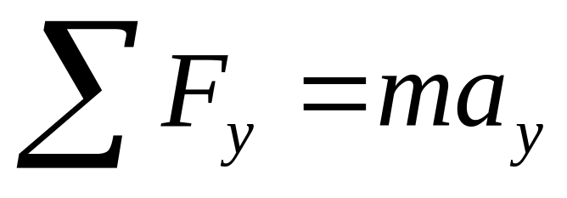
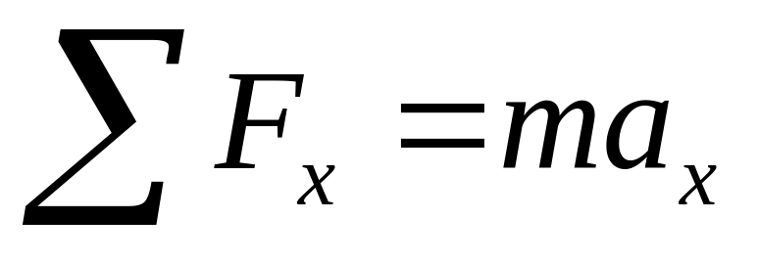
5.4 The Vector Nature of Newton’s Second Law
The direction of force and acceleration vectors
can be taken into account by using x and y
components.
is equivalent to

Slide 20
5.5 Newton’s Third Law of Motion
Newton’s Third Law of Motion
Whenever one body exerts a force on a
second body, the second body exerts an
oppositely directed force of equal magnitude on the first body.

Slide 21
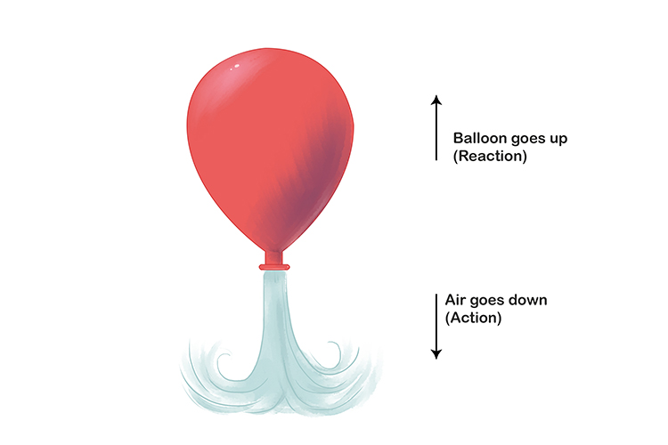

Slide 22
Action & reaction acts on different bodies
Action-reaction pair are of same nature
Force always exist in pair

Slide 23
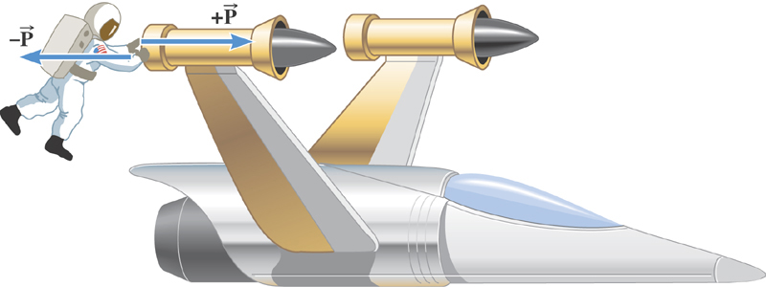
5.5 Newton’s Third Law of Motion
Suppose that the magnitude of the force is 36 N. If the mass
of the spacecraft is 11,000 kg and the mass of the astronaut
is 92 kg, what are the accelerations?

Slide 24
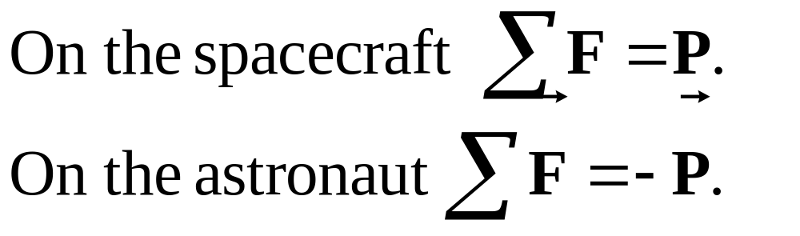
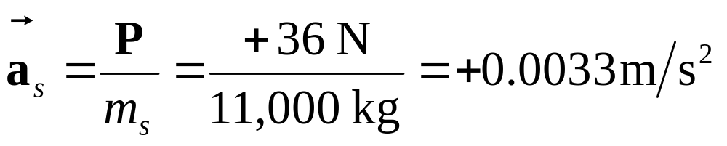
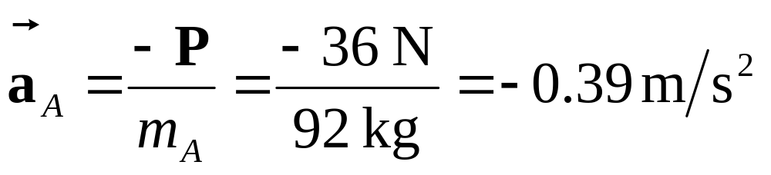
5.5 Newton’s Third Law of Motion

Slide 25
5.6 Types of Forces: An Overview
Examples of different forces:
Friction force
Tension force
Normal force
Weight (Force due to gravity)
Gravitational Force
Magnetic Force
Electric Force

Slide 26
5.7 The Gravitational Force
Definition of Weight
The weight of an object on or above the earth is the gravitational force that the earth exerts on the object. The weight always acts downwards, toward the center
of the earth.
SI Unit of Weight: newton (N)

Slide 27
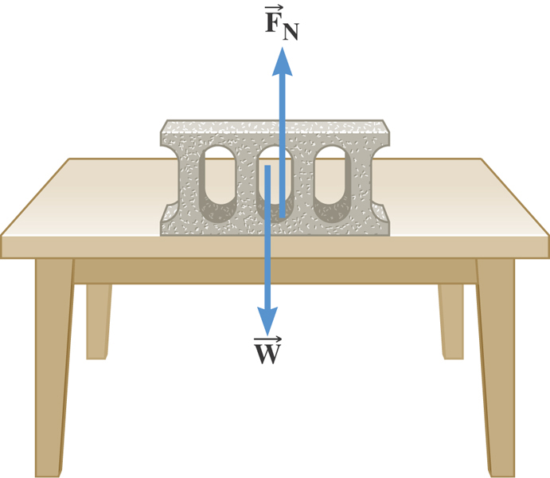
5.8 The Normal Force
Definition of the Normal Force
The normal force is one component of the force that a surface
exerts on an object with which it is in contact –
perpendicular to the surface.

Slide 28
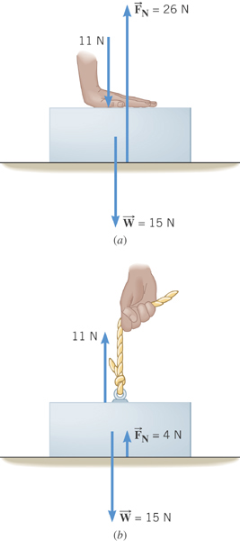
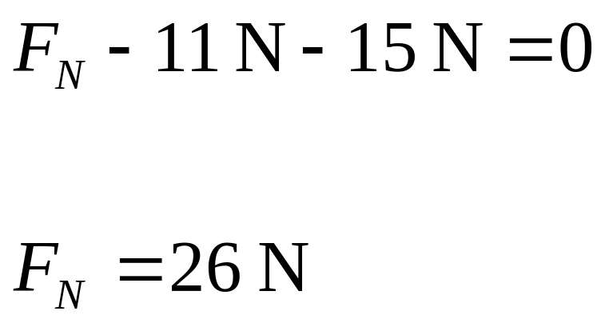
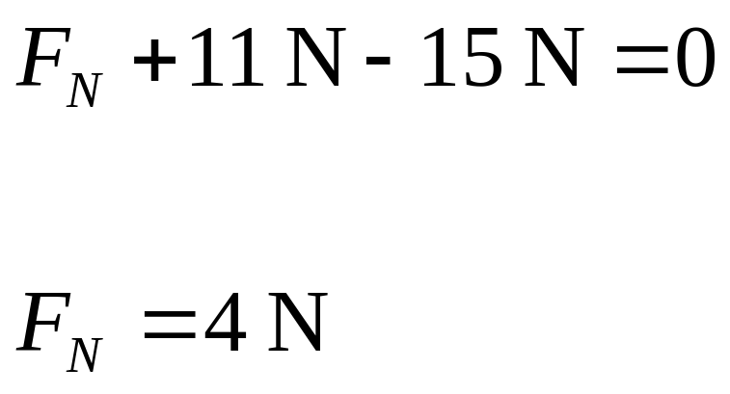
5.8 The Normal Force

Slide 29
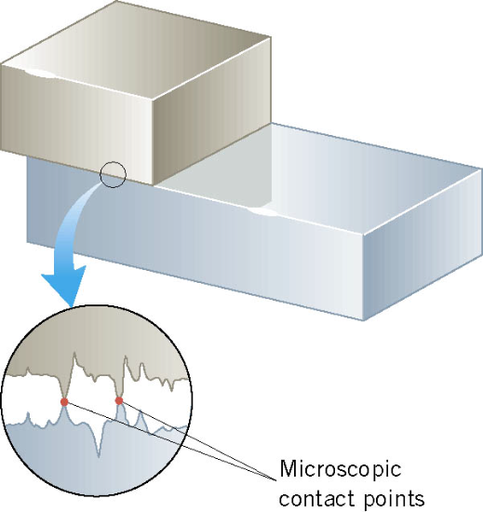
5.9 Frictional Forces
When an object is in contact with a surface there is a force
acting on that object. The component of this force that is
parallel to the surface is called the
frictional force.

Slide 30
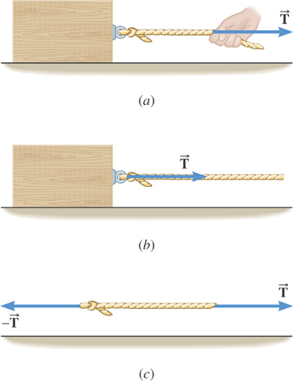
5.10 The Tension Force
Cables and ropes transmit
forces through tension.

Slide 31
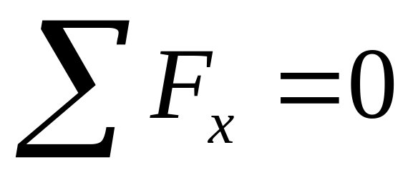
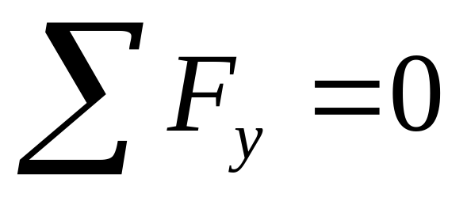
5.11 Equilibrium Application of Newton’s Laws of Motion
Definition of Equilibrium
An object is in equilibrium when it has zero acceleration.

Slide 32
5.11 Equilibrium Application of Newton’s Laws of Motion
Reasoning Strategy
Draw a free-body diagram.
Include only forces acting on the object, not forces the object
exerts on its environment.
Choose a set of x, y axes for each object and resolve all forces in the free-body diagram into components that point along these
axes.
Apply the equations and solve for the unknown quantities.

Slide 33
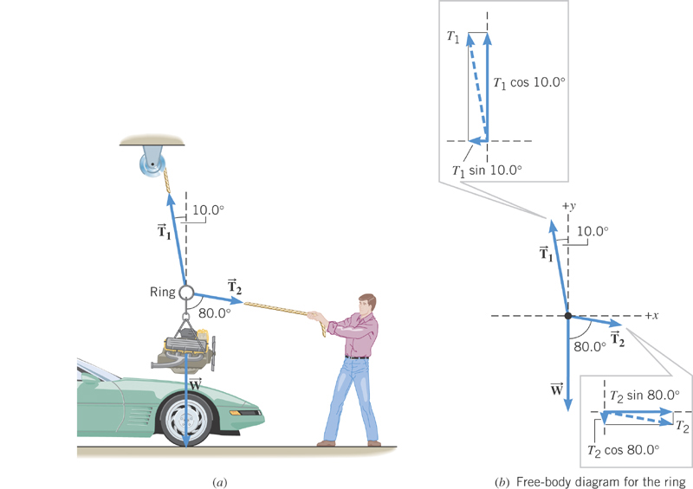
5.11 Equilibrium Application of Newton’s Laws of Motion

Slide 34
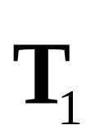
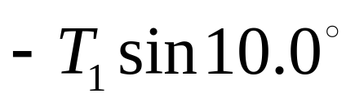
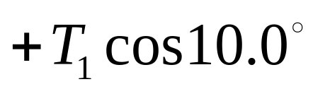
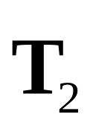
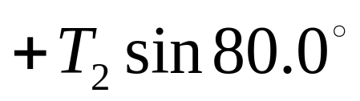
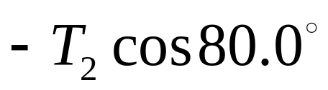




5.11 Equilibrium Application of Newton’s Laws of Motion
Force | x component | y component

Slide 35
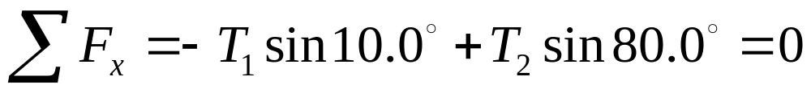
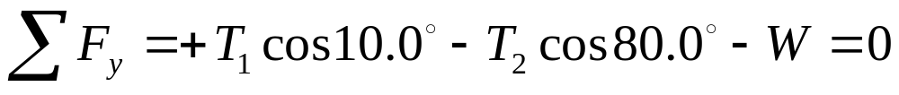
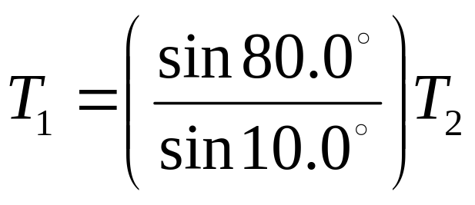
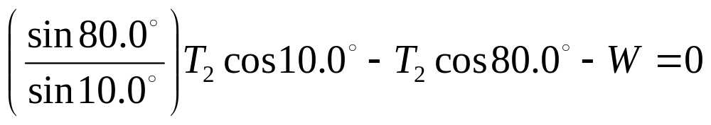
5.11 Equilibrium Application of Newton’s Laws of Motion
The first equation gives
Substitution into the second gives

Slide 36
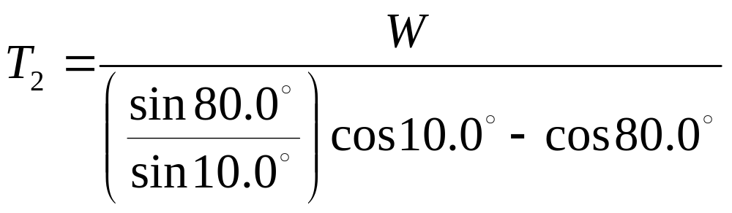
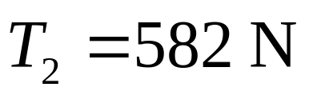
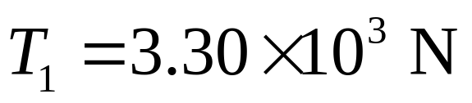
5.11 Equilibrium Application of Newton’s Laws of Motion

Slide 37

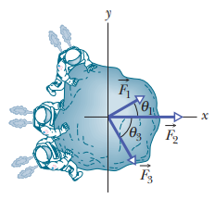
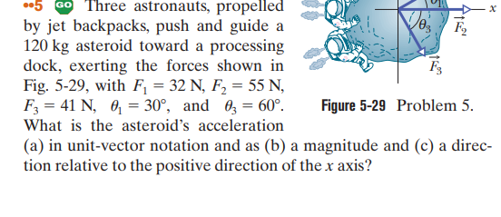

Slide 38
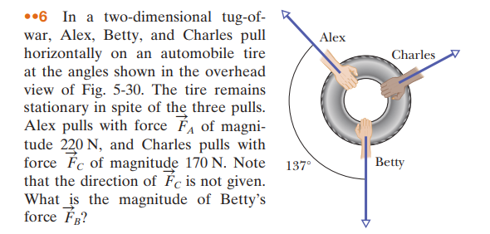

Slide 39
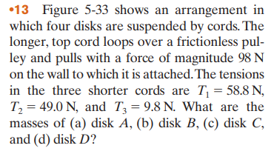
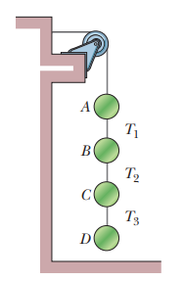
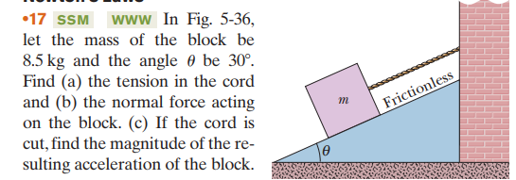

Slide 40
